Slide 1

Momo Medical Week 11
Salah Abdulkader, Theo van den Berg, Roy Duivenvoorden, Nick Keereweer, Floris van Lingen, Jeanine Nagy

Slide 2
Table of contents
What did we do?
Dataframes and models
Binary vs multi class
What are we going to do?

Slide 3
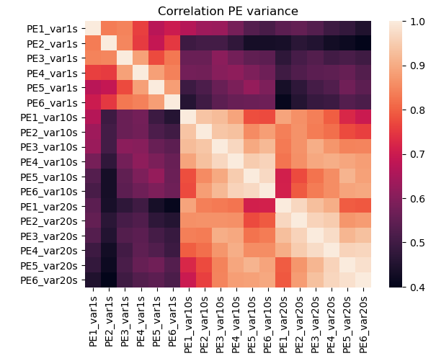
What did we do?
Worked on our:
model
code
(potential) features
Read up on models
polynomial
one class SVM

Slide 4
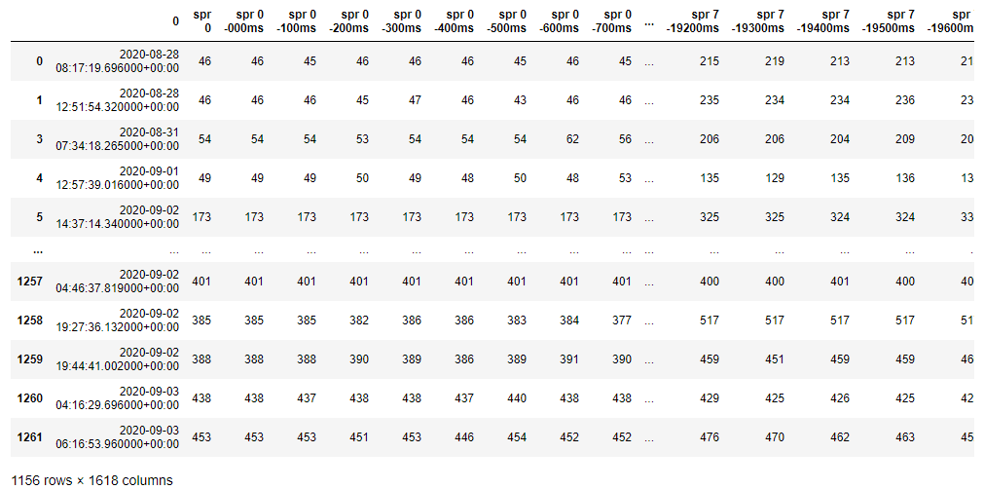
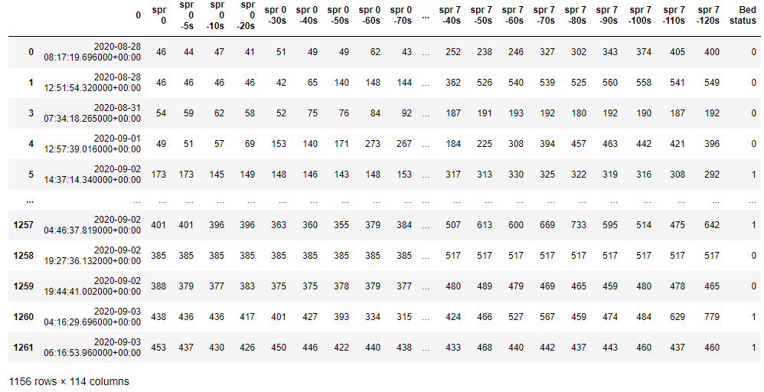
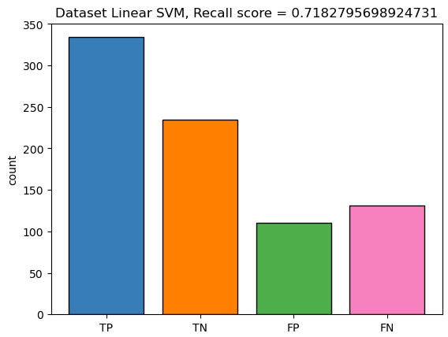
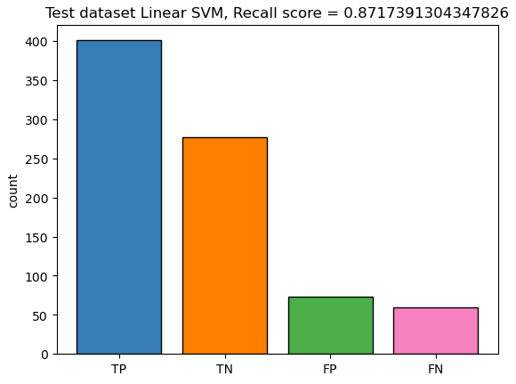
Dataframes and models

Slide 5
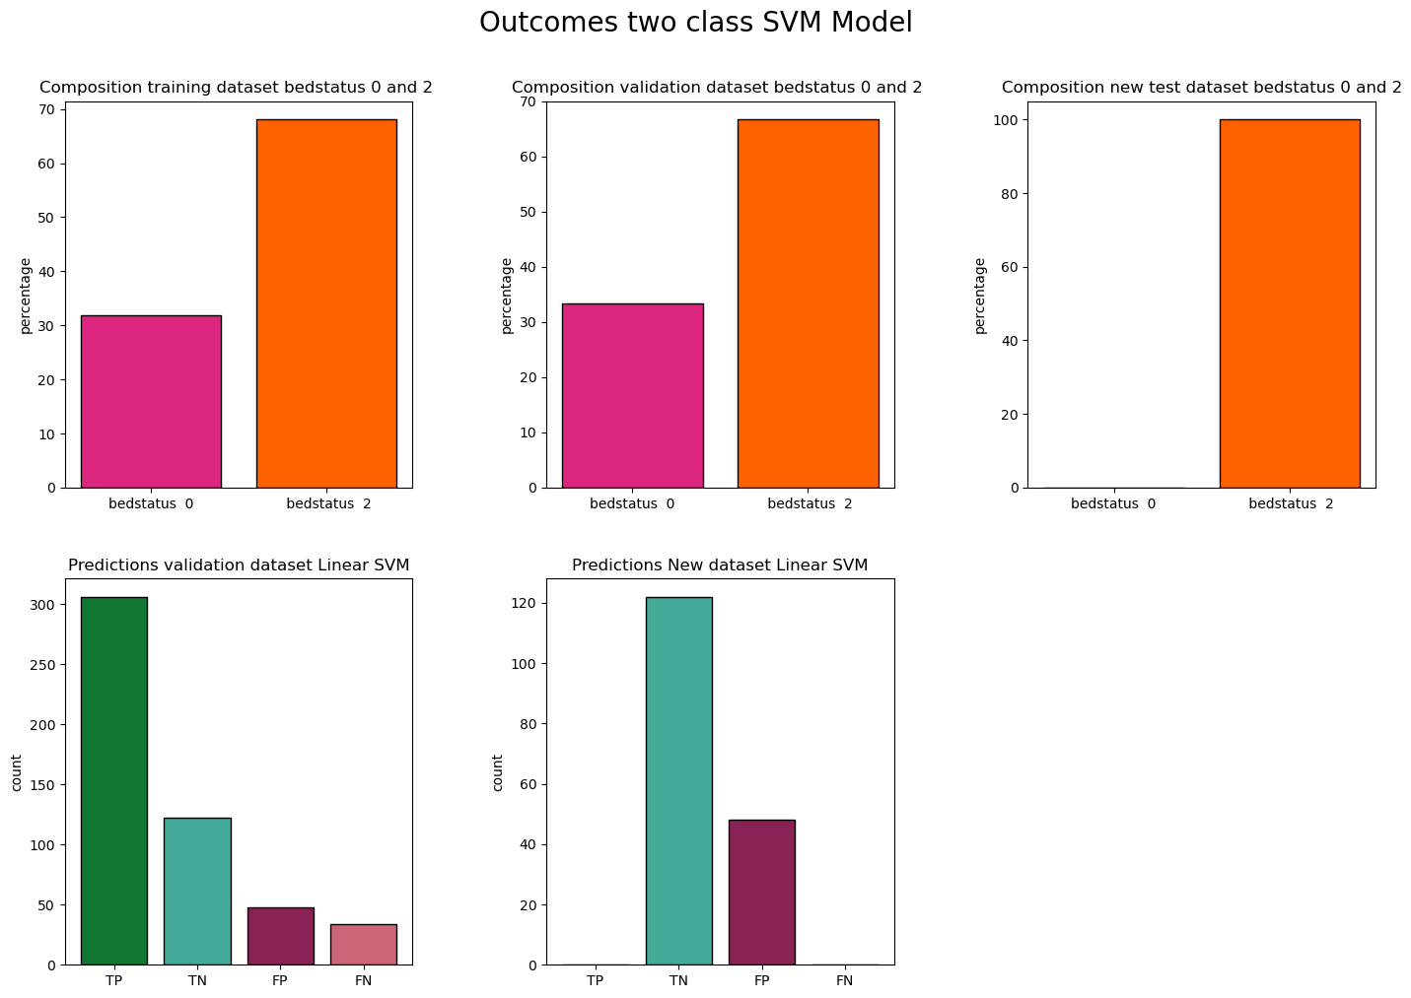
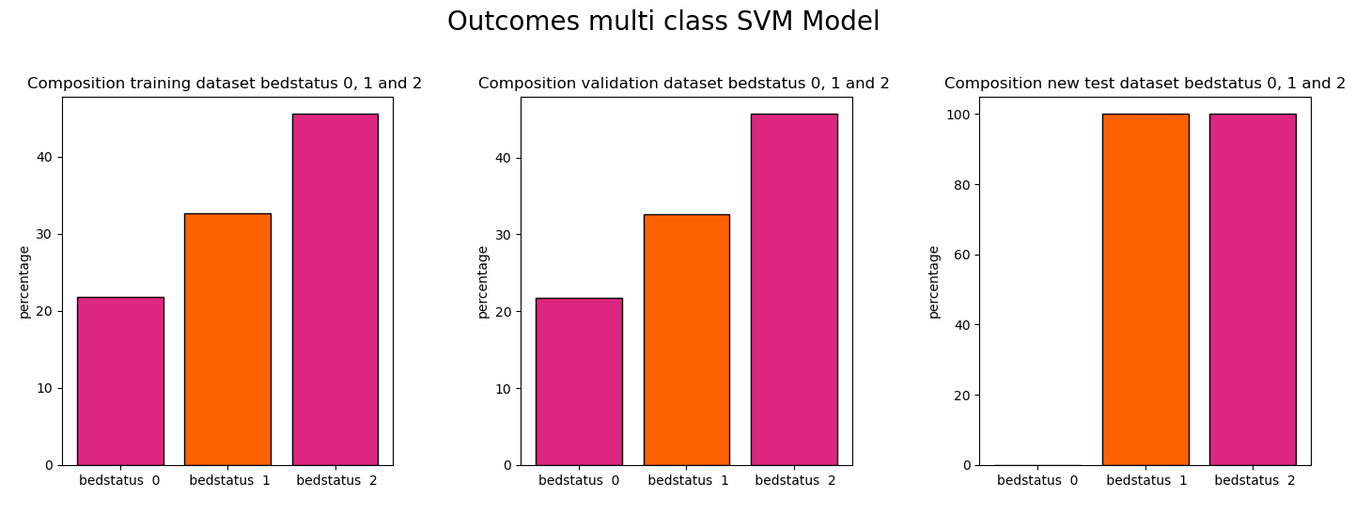
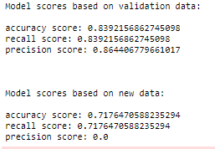
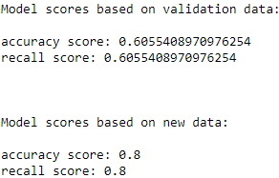
Binary vs multi class

Slide 6
What are we going to do?
Further tuning of our current models
Physical meeting with Momo
Expending our features
Looking for new features
Looking into other models
Polynomial
One class SVM

Slide 7
Questions?

